Slide 1
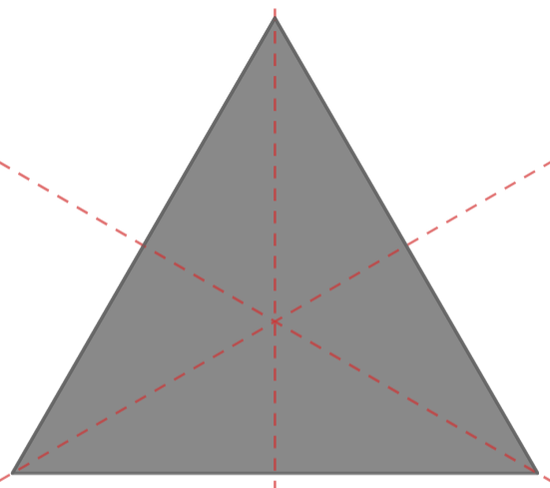
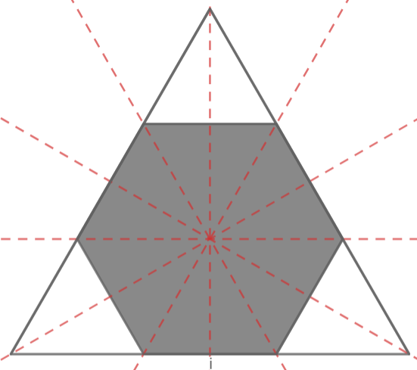
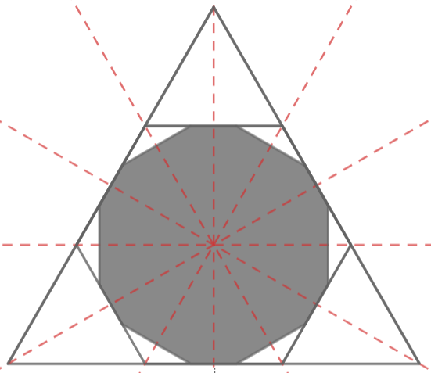









Slide 2
A
rn
D
h
h’
rn+1
C
B
E

Slide 3


$$α$$

Slide 4
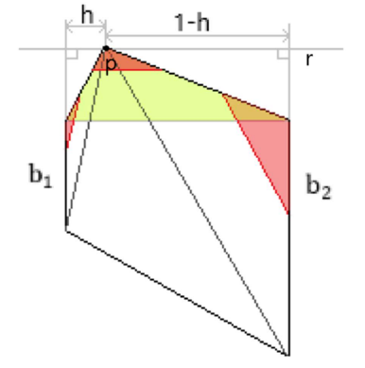
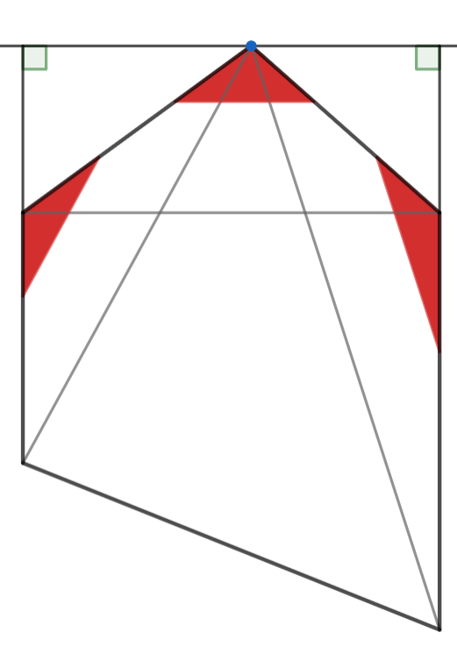








$$h$$
$$p$$
$$1−h$$
$$r$$
$$t_{1}$$
$$t_{2}$$
$$b_{1}$$
$$b_{2}$$

Slide 5





Vértices:
$$∈P_{n}$$
$$∈P_{n+1}$$
$$∈P_{n+2}$$
$$1/9$$
$$1/9$$

